Slide 1

Supermarket analysis
PYTHON

Slide 2

Project goals
1 | Analyzing Dataset
2 | Loading & Filtration
3 | Determining feature & Target
4 | Executing Encoding techniques
5 | Finding the error

Slide 3

INTRODUCTION
In this project, we will be using Python to analyze the supermarket sales dataset. We will perform data cleaning, preprocessing, and exploratory data analysis to understand
the patterns and trends in the data. We will also create visualizations and reports to
present the data and gain insights

Slide 4

Primary Goals
Build A Prediction Machine

Slide 5

PROJECT PLANS
Pre Process
Predict
Removing Nans & Errors
Predict with the help of training and testing data
2
4
Splitting
Error Handling
Splitting the data into training and testing
Find Error Ratio & Error Rate
1
LOAD
Load CSV into Python
3
5

Slide 6





Libraries Used
Pandas
NumPy
Ski Learn
matplotlib
1-HOt
To manage with the dataset
Array Handling
To apply Regression System
To Draw Charts and Visualizations
To perform categorical encoding
YEAR 2023

Slide 7

Building learning model
Steps of building learning model
Loading
Pre Processing
Selecting Target & Feature
Performing One Hot Encoding
Splitting into training and testing data
Applying Linear Regression
Predicting
Mean Squared Error
R Squared Error

Slide 8
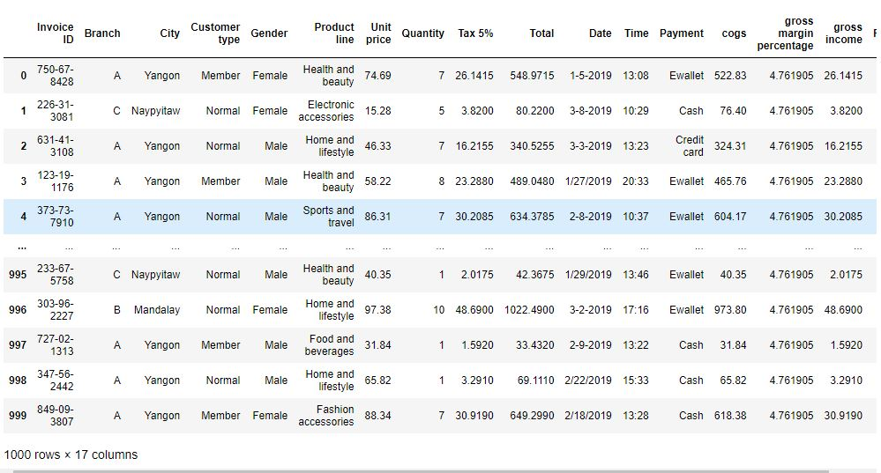
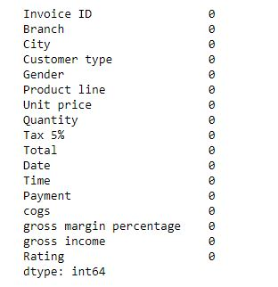
Learning model
Loading Data
RW=pd.read_csv(r"C:\Users\harsh\Downloads\Kaggel Dataset Python Final Capstone\supermarket_sales.csv")
Removing nulls
print(RW.isnull().sum())

Slide 9
Learning model
Target = RW['Rating’]
Feature = RW[['Invoice ID', 'Branch', 'City', 'Customer type', 'Gender',
'Product line', 'Unit price', 'Quantity', 'Tax 5%', 'Total', 'Date',
'Time', 'Payment', 'cogs', 'gross margin percentage', 'gross income']]
Selecting TARGET & FEATURE
RW['Branch'] = encoder.fit_transform(RW[['Branch']])
RW['City'] = encoder.fit_transform(RW[['City']])
RW['Customer type'] = encoder.fit_transform(RW[['Customer type']])
RW['Gender'] = encoder.fit_transform(RW[['Gender']])
RW['Product line'] = encoder.fit_transform(RW[['Product line']])
RW['Payment'] = encoder.fit_transform(RW[['Payment']])
ONE hot encoding

Slide 10
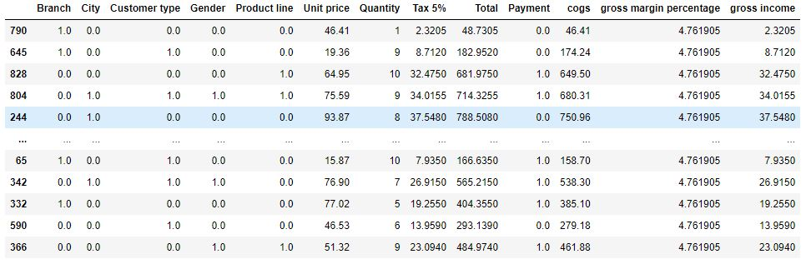
Learning model
Splitting test & Train DAta
X_train, X_test, y_train, y_test = train_test_split(Feature,Target, test_size=0.2)
Linear Regression
CLFLR.fit(X_train,y_train)

Slide 11
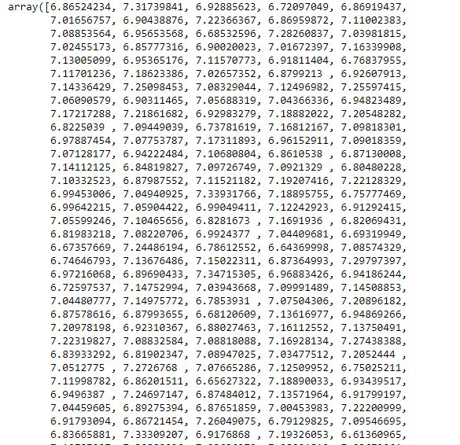
Learning model
PREDICTING
CLFLR.predict(X_test)
Mean squared
MSEOD = mean_squared_error(CLFLR.predict(X_test),y_test)
print("Mean squared error:", MSEOD)
R SQUARED ERROR
RSQES = r2_score(CLFLR.predict(X_test),y_test)
print("R squared error:", RSQES)

Slide 12
SUMMARY
This analysis on the supermarket sales data gives us the insight about all the customers belonging from different cities like the product lines ,quantity of product they are interested in buying . This in-depth analysis help us understand the sales trend & customer behavior. we can gain insights into which products are selling the most, what factors influence sales, and which customers are the most valuable

Slide 13

THANK YOU

